Slide 1
Shaders and PBR
Jessica Kasson, Paul Kim, Matt Mohr, and Trevor Parks

Slide 2
Overview
Shaders
Mobile Shaders
Blurring
PBR

Slide 3
Shaders

Slide 4
Fixed Function Pipeline (FFP)
Graphics rendering pipeline used in older GPU (before 1998)
Easy for beginner to use (does not need to set up much)
Core algorithms are hard coded in graphics hardware.
Uncontrollable
Notes:
to show why we use shader

Slide 5
Programmable Pipeline
Developed from FFP as graphics hardware evolved
Controllable
Available to use own algorithm for shading
Programmable by computer program called Shader!
Notes:
It is programmed in shader..attaching customized algorithm to rendering pipeline

Slide 6
Shaders
Computer program used to shading
Modern use of shader was introduced by Pixar’s Renderman (1988)
Major graphics software libraries (OpenGL, Direct 3D) began to support shaders as GPU evolved
Programmed by shading language (GLSL, HLSL, etc)

Slide 7
Shaders in programmable pipeline
Vertex shader
Fragment shader

Slide 8
Vertex Shader
Processes on each vertex
Manipulates vertex attributes (position, normal vector, texture coordinate, etc)
Transform the vertex position to screen space
Pass manipulated attributes data over to the fragment shader
Notes:
moving vertices

Slide 9
Fragment Shader
Processes on each fragment generated by rasterization
Linearly interpolated values from the vertex shader as input
Output actual color value for each pixel on a screen

Slide 10
Shaders in Unity
Written in HLSL
Surface shader
Use lighting model by setting up intuitive properties (Albedo, Specular, Gloss, etc)
For realistic material affected by light
Vertex and fragment shader
Same with vertex shader and fragment shader discussed previously
No built-in semantic for lighting
Need to write custom lighting model
For non realistic material or 2D graphics
Notes:
can setup three shaders

Slide 11
Mobile Shaders

Slide 12
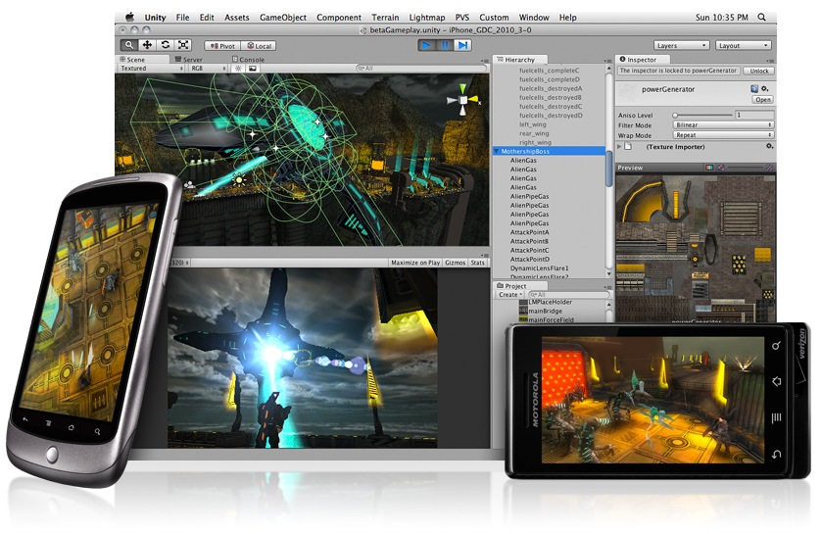
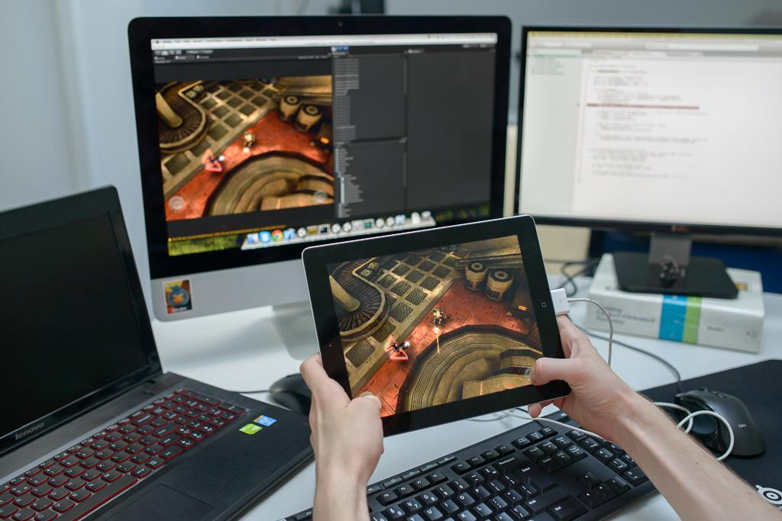
Mobile Shaders - Challenges
Mobile GPUs must produce less heat, power, and noise than desktop GPUs -> less bandwidth, low ALU performance, less texturing power.
Resolved by smart rendering shortcuts: material count must be kept low, texture atlasing* helps, use lightmapping* whenever possible, and so on.
http://docs.unity3d.com/Manual/MobileOptimisation.html

Slide 13
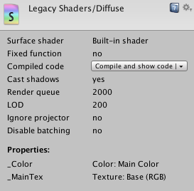
Mobile Shaders - Given Limitations
Performance is fillrate bound
defined by Unity as: fillrate = screen pixels * shader complexity * overdraw
Unity’s included mobile shaders help to cut down on the shader complexity component of that.
… supposedly, but I did not see that, at least not with the legacy vs. mobile diffuse shaders.
Pixel and geometric complexity
Vertex count and/or draw call count = more GPU load as usual; Occlusion culling* also helps as it would for other areas..
Memory bandwidth
Largely noticed with textures; would help reducing the Texture Quality in Quality Settings (get picture!), also compressing textures, using mipmaps, reducing texture size, and so on.

Slide 14
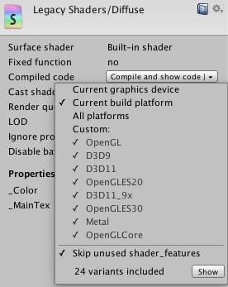
Mobile Shaders - Device Compatibility
Android and iOS support the graphics renderer OpenGL ES, so they require GLSL shaders.
Modern iOS devices as of 2015 may also support the graphics renderer Metal in addition to OpenGL ES, which has its own shader type.
Unlike Desktop Windows, Windows Phones do NOT support OpenGL (ES). Only Direct3D’s HLSL shaders; WP8 onwards allowing custom shaders, specific. in the Direct3D9 shader model
Unity is optimized for OpenGL ES 2.0, thus uses the GLSL ES shading language.
Different GPUs have different limitations (PowerVR needs Tiled rendering*, Nvidia Tegra can render however)
http://docs.unity3d.com/Manual/MobileOptimisation.html
http://blogs.unity3d.com/2015/02/19/unity-4-6-3-metal-rendering-support-and-update-of-il2cpp-for-ios/
https://msdn.microsoft.com/en-us/library/windows/apps/jj714072(v=vs.105).aspx

Slide 15
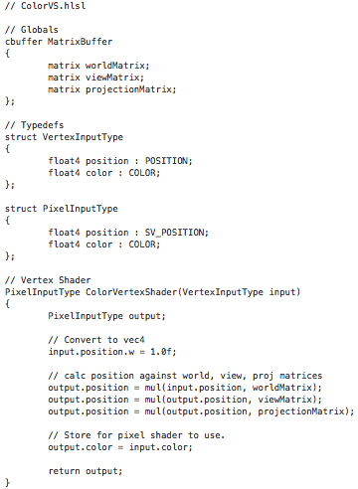
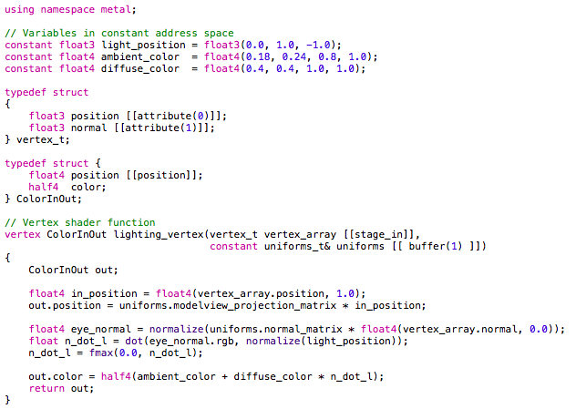
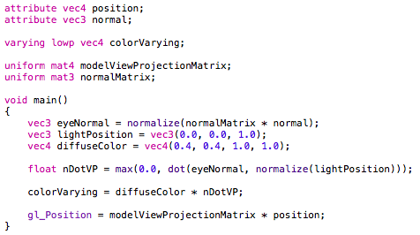
Mobile Shaders - Mobile APIs of Choice
GLSL: OpenGL (ES) Shading Language
Metal: Metal Shading Language
HLSL: Direct3D - “High Level Shading Language”
Syntax all different, but similar to C/C++.

Slide 16
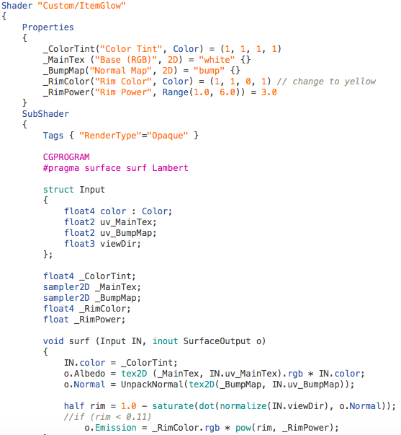
Mobile Shaders - Unity’s Scope
In Unity, shaders are written in Cg, Nvidia’s shading language, by default. This can be similar to HLSL, Direct3D’s shading language, so Unity doesn’t distinguish between them.
For mobile platforms (Android/iOS), these built-in shaders are cross-compiled into GLSL (ES).
Windows, HLSL?
https://en.wikibooks.org/wiki/Cg_Programming/Unity

Slide 17
Blurring

Slide 18
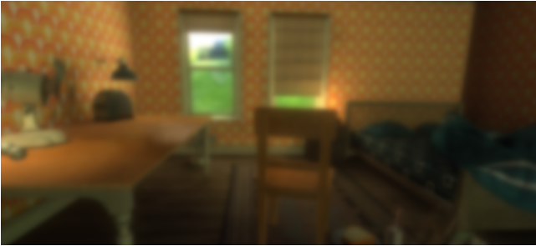
Blurring
Blur - To make or to become unclear or less distinct
Imaging Processing
Commonly implemented using Gaussian Blur

Slide 19
Gaussian Distribution
Also known as the Normal Distribution or Bell Curve
Used in statistics
σ = standard deviation
1-D Gaussian Distribution
2-D Gaussian Distribution

Slide 20
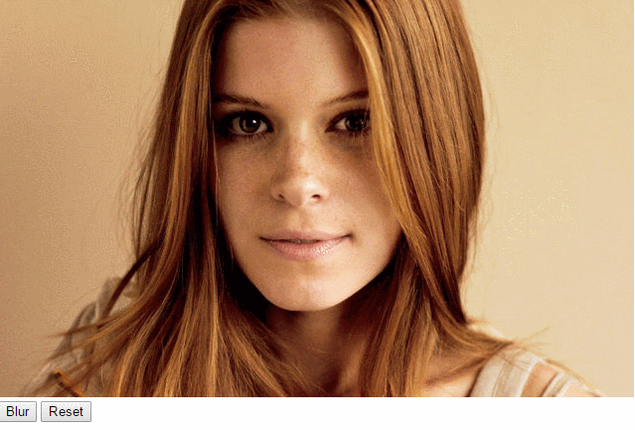
Algorithm
Create Kernel using Gaussian function
Use convolution to calculate the RGB values of specific pixel
Pass over every pixel in image
Repeat step 2 and 3

Slide 21
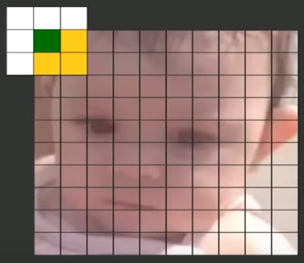
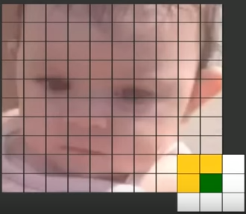
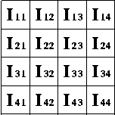
Convolution
Runs a kernel over an image to calculate output pixel values
Modifies pixel values based on its neighborhood of pixels
O(1,1) = I(1,1)K(1,1) + I(2,1)K(2,1) + I(1,2)K(1,2) + I(2,2)K(2,2)
Image
Kernel

Slide 22
Improvements of 1-D Gaussian Kernel
Performance can be improved by using a 1-D horizontal kernel and a 1-D vertical kernel, instead of doing 2-D kernel
Decreases the time from O(m^2 * n^2) to O(m^2 * 2n) where m is the image’s dimensions and n is the kernel’s
Still get same result as 2-D kernel due to Gaussian properties

Slide 23
Kernel Implementation

Slide 24
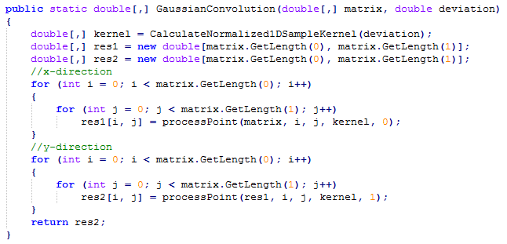
Convolution Implementation

Slide 25
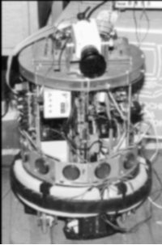
Useful Tips
7x7 kernel is best due to Gaussian values being close to zero when they are farther than 3 standard deviations away. (Center plus both sides)
Should normalize your kernel so the image doesn’t darken or brighten
The larger σ and kernel size, the greater the blur
σ = 1
kernel = 5x5
σ = 4
kernel = 15x15

Slide 26
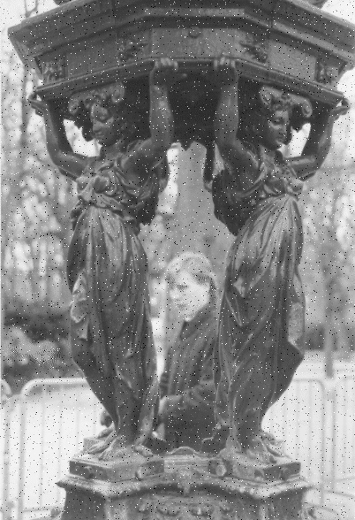
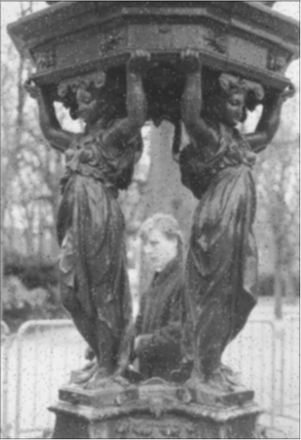
Additional Uses
Removing noise
Edge Detection
Krisch Detector

Slide 27
Blurring in Unity
Blur Iterations - The number of passes the kernel goes through the image
Blur Size - Probably increases number of pixels sampled
It is hard to trace through Unity scripts

Slide 28
Physically Based Rendering (PBR)

Slide 29
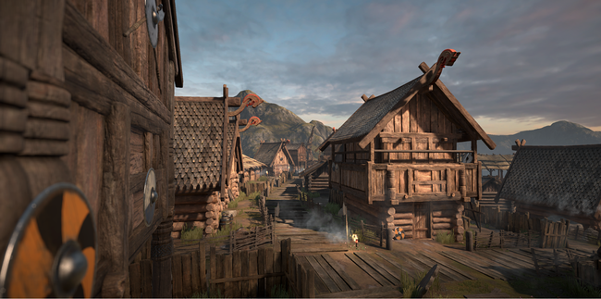
The Standard Shader is lovely

Slide 30
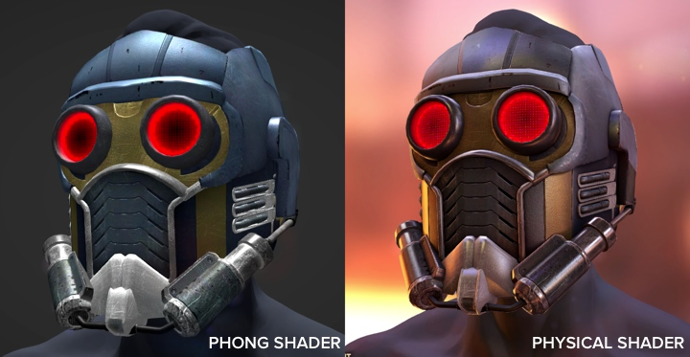
What is PBR?
Well, a lot of things
PBR typically refers to accounting for physical elements of light, reflection, energy conservation, and microsurface diffusion
Unlike shaders, PBR is a newish and exciting part of real time rendering
Unfortunately, this means that there is no central PBR database or guideline
For instance, there is no Physically Based Rendering Wikipedia page

Slide 31
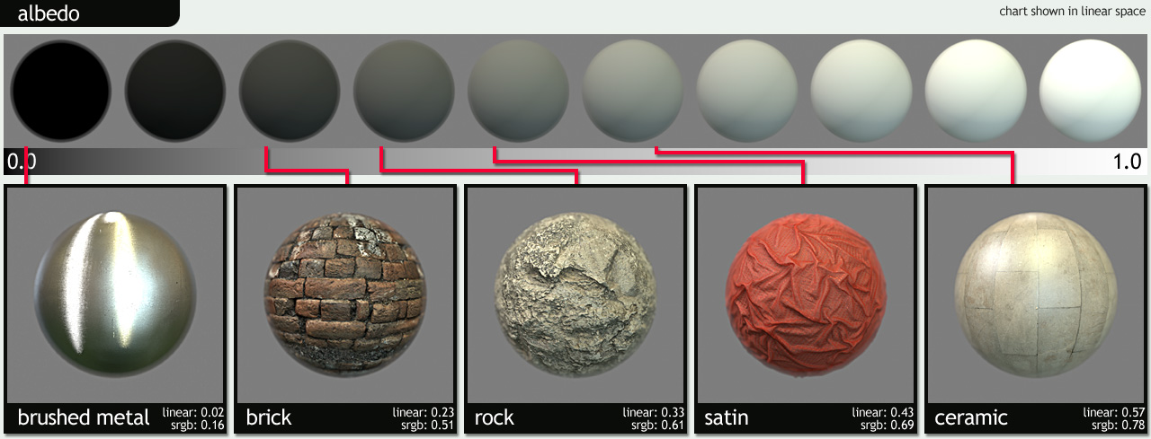
Parts of a typical PBR system - Albedo and Conservation
http://www.marmoset.co/toolbag/learn/pbr-practice
Notes:
Energy conservation: Roughly similar to standard shader’s smoothness and metalness
Albedo: In a PBR system, albedo does not account for AO or a directional light. General tint.

Slide 32
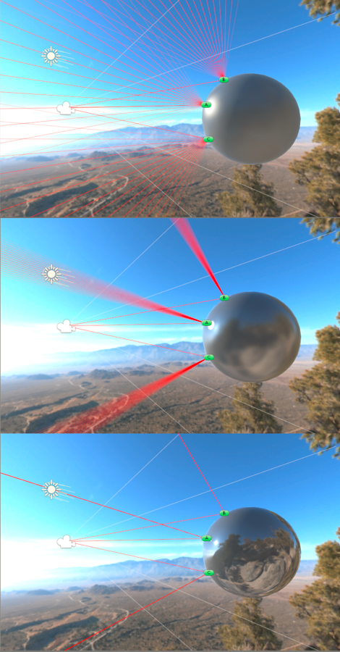
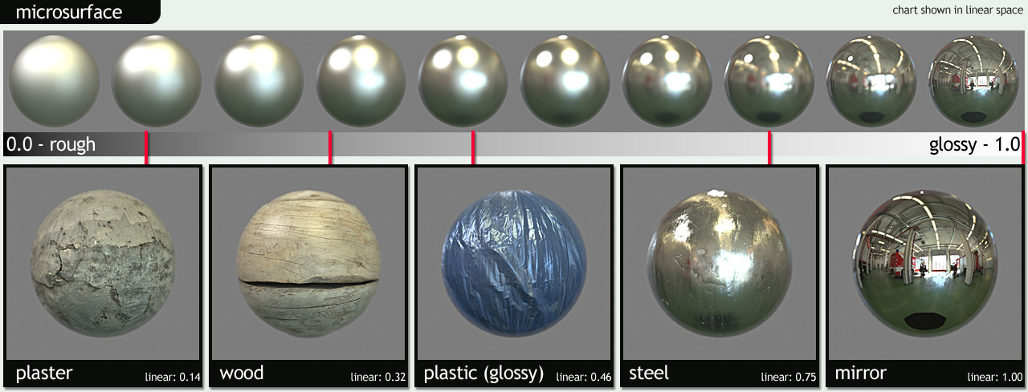
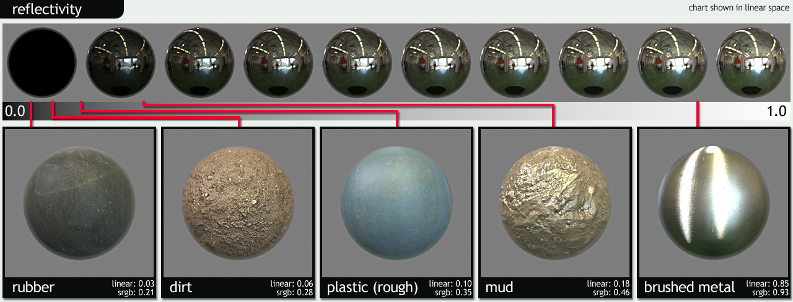
PBR - Reflectvity
Notes:
Microsurface: Roughly equivalent to roughness in SS. Lower microsurface smoothess relates to wider and dimmer specular reflections. Higher microsurface smoothness relates to sharper, brighter reflections.
Reflectivity: Note the narrow range of reflectivity for non-metal surfaces. For the most part, for non-metal surfaces, you’re gonna lean on a microsurface map. Otherwise, a reflectivity map will be the way to go.

Slide 33
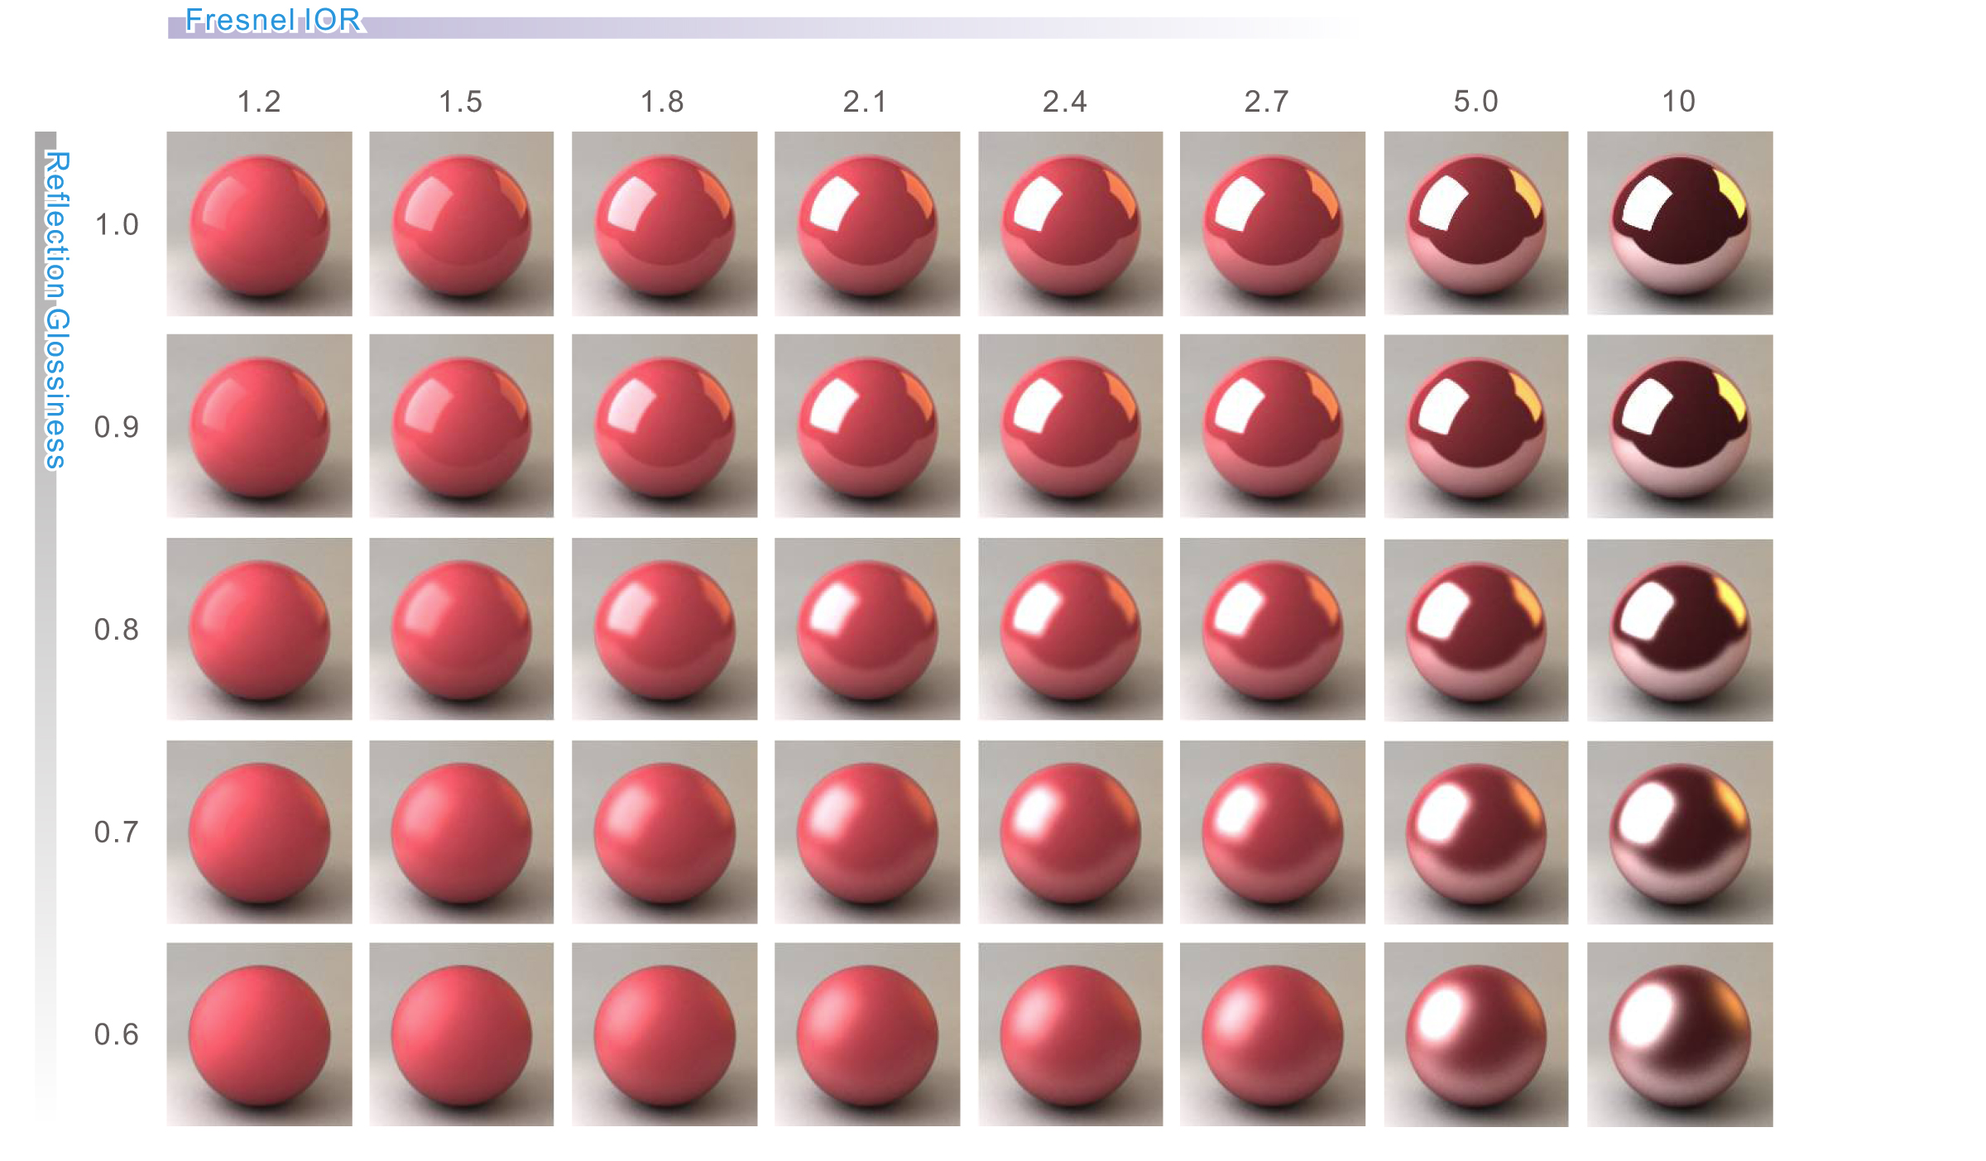
PBR - Fresnel Effect
Notes:
Fresnel has to do with the light reflected on the graze angle of a surface. Easier to see in the upper diagram. The Standard shader currently has no direct effect on the Fresnel effect, it is indirectly controlled by smoothness.

Slide 34
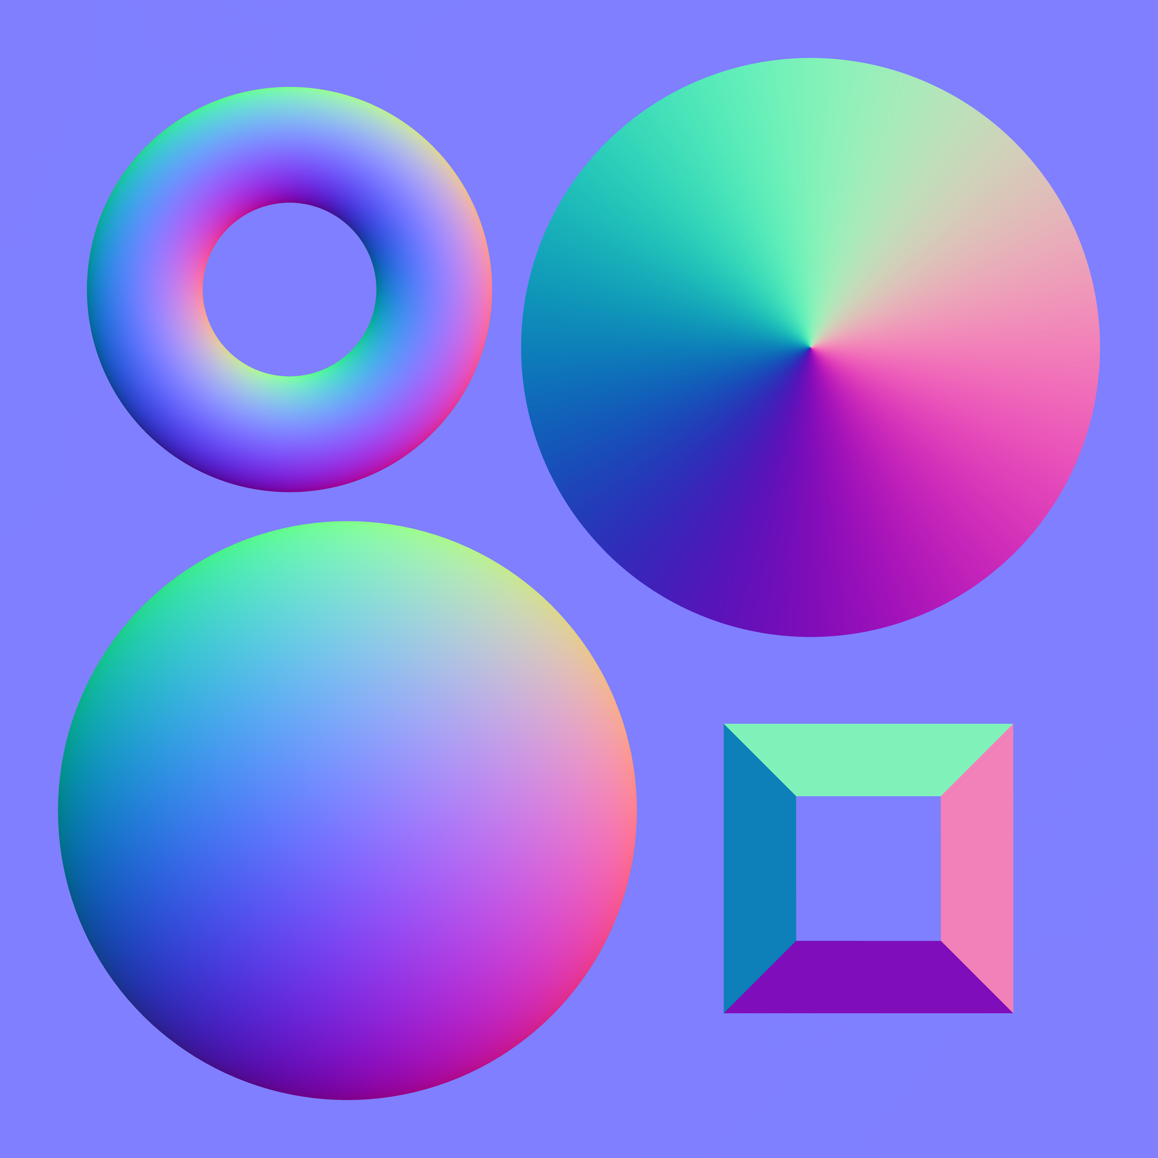
Maps, maps, maps
Now that we know a little more about how a PBR system works, how would we use it?
Normal maps, reflection maps, specular maps, albedo maps are the way to go to make PBR system work with a texture
After explanation, a demo in Quixel Suite

Slide 35
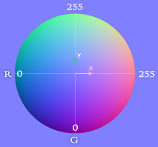
Normal Map

Slide 36
Bumpmap
Albedo only
Bump Map
Albedo and Bump Map

Slide 37
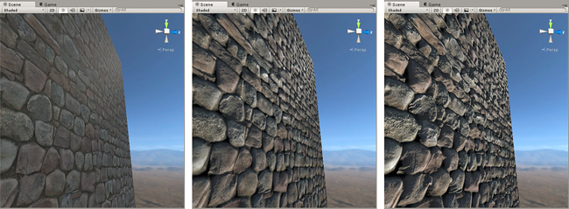
Heightmap
Albedo only
Albedo with Normal
Albedo, Normal, Heightmap

Slide 38
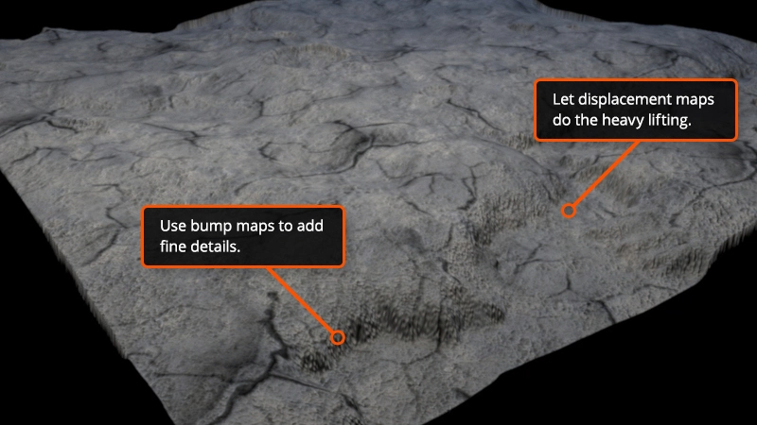
Bump Map vs Heightmap vs Normal Map
Normal maps indicate light normals on the surface of a mesh
Heightmaps (displacement maps) displace pixels at render time to handle large displacements of pixels.
Bump maps add smaller details

Slide 39
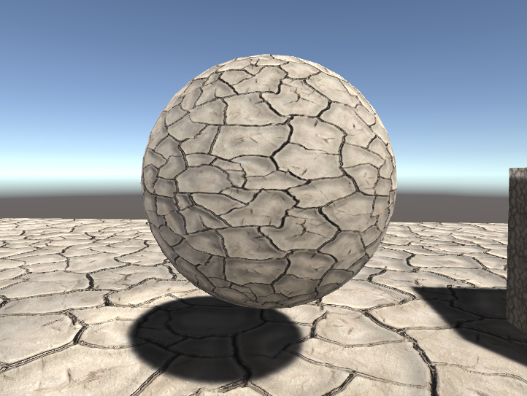
Let’s make some mud

Slide 40
References
Shaders:
http://www.cs.kent.edu/~zhao/gpu/lectures/ProgrammableGraphicsPipeline.pdf
https://en.wikipedia.org/wiki/Shader
http://www.3darchitettura.com/pixar-renderman-free/
https://glumpy.github.io/modern-gl.html
http://www.alanzucconi.com/2015/06/10/a-gentle-introduction-to-shaders-in-unity3d/
http://www.alanzucconi.com/2015/06/17/surface-shaders-in-unity3d/
http://www.alanzucconi.com/2015/07/01/vertex-and-fragment-shaders-in-unity3d/

Slide 41
References
Blurring:
http://elynxsdk.free.fr/ext-docs/Blur/Fast_box_blur.pdf
http://haishibai.blogspot.com/2009/09/image-processing-c-tutorial-4-gaussian.html
http://rastergrid.com/blog/2010/09/efficient-gaussian-blur-with-linear-sampling/
https://www.youtube.com/watch?v=7LW_75E3A1Q&index=12&list=WL
https://en.wikipedia.org/wiki/Gaussian_blur
http://homepages.inf.ed.ac.uk/rbf/HIPR2/gsmooth.htm
https://en.wikipedia.org/wiki/Normal_distribution#Development
http://homepages.inf.ed.ac.uk/rbf/HIPR2/convolve.htm
http://docs.unity3d.com/Manual/script-BlurOptimized.html

Slide 42
Questions?

